Slide 1
Java Applet

Slide 2
Java Applet
Applet is a special type of program that is embedded in the webpage to generate the dynamic content.
It runs inside the browser and works at client side.

Slide 3
Advantage of Applet
It works at client side so less response time.
Secured
It can be executed by browsers running under many plateforms, including Linux, Windows, Mac Os etc.

Slide 4
Drawback of Applet
Plugin is required at client browser to execute applet.

Slide 5
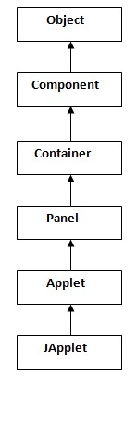
Hierarchy of Applet

Slide 6
Life Cycle States of Java Applet
Applet is initialized.
Applet is started.
Applet is painted.
Applet is stopped.
Applet is destroyed.

Slide 7
Lifecycle methods for Applet
The java.applet.Applet class 4 life cycle methods and java.awt.Component class provides 1 life cycle methods for an applet.
java.applet.Applet class
For creating any applet java.applet.Applet class must be inherited. It provides 4 life cycle methods of applet.
public void init(): is used to initialized the Applet. It is invoked only once.
public void start(): is invoked after the init() method or browser is maximized. It is used to start the Applet.
public void stop(): is used to stop the Applet. It is invoked when Applet is stop or browser is minimized.
public void destroy(): is used to destroy the Applet. It is invoked only once.

Slide 8
java.awt.Component class
The Component class provides 1 life cycle method of applet.
public void paint(Graphics g): is used to paint the Applet. It provides Graphics class object that can be used for drawing oval, rectangle, arc etc.

Slide 9
Who is responsible to manage the life cycle of an applet?
Java Plug-in software.

Slide 10
How to run an Applet?
1. By appletViewer tool (for testing purpose).
2. By html file.

Slide 11
1. By appletviewer
Syntax: appletviewer html_file_name
Ex: appletviewer firstApplet.html

Slide 12
Note
In IDE, applet program can be run directly
Right click on java file → Run as Java applet

Slide 13
2. By Html file
Sometimes for security reasons, Applet programs can’t be run directly in browser.
We need to do following changes to run applet programs in system
We can add some exceptional sites (local urls can be added)
1. Open ConfigureJava (search for Configure Java)
2. Click on security tab
3. Click on Edit sites list button
4. Click on Add button
5. Add the html file full url with prefix file:///
Eg: file:///C:\Users\marepalli\Desktop\JavaApplets\myApplet.html

Slide 14
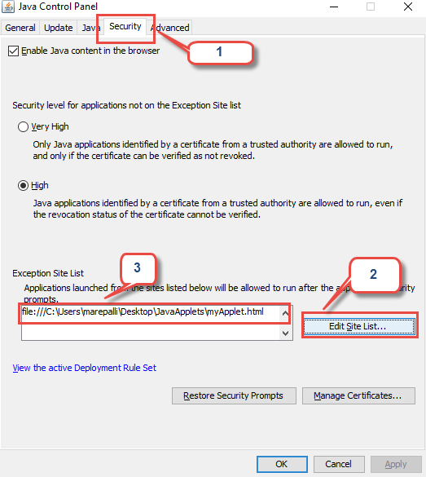

Slide 15
Simple example of Applet by html file:
To execute the applet by html file, create an applet and compile it. After that create an html file and place the applet code in html file. Now click the html file.
Note: class must be public because its object is created by Java Plugin software that resides on the browser.

Slide 16
Note:
Make sure java class and html files are in same location to execute to avoid ClassNotFoundException

Slide 17
First.java
import java.applet.Applet;
import java.awt.Graphics;
public class First extends Applet{
public void paint(Graphics g){
g.drawString("welcome",150,150);
}
}

Slide 18
myapplet.html
<html>
<body>
<applet code="First.class" width="300" height="300">
</applet>
</body>
</html>

Slide 19
Life Cycle Methods Example
public class LifeCycleApplet extends Applet {
public void init() {
System.out.println("init method");
}
public void start() {
System.out.println("start method ");
}
public void stop() {
System.out.println("stop method");
}
public void destroy() {
System.out.println("destroy method");
}
public void paint(Graphics g) {
g.drawString(“Welcome”, 300, 300);
} }

Slide 20
Displaying Graphics in Applet
java.awt.Graphics class provides many methods for graphics programming.

Slide 21
Commonly used methods of Graphics class
public abstract void drawString(String str, int x, int y): is used to draw the specified string.
public void drawRect(int x, int y, int width, int height): draws a rectangle with the specified width and height.
public abstract void fillRect(int x, int y, int width, int height): is used to fill rectangle with the default color and specified width and height.
public abstract void drawOval(int x, int y, int width, int height): is used to draw oval with the specified width and height.
public abstract void fillOval(int x, int y, int width, int height): is used to fill oval with the default color and specified width and height.
public abstract void drawLine(int x1, int y1, int x2, int y2): is used to draw line between the points(x1, y1) and (x2, y2).
public abstract boolean drawImage(Image img, int x, int y, ImageObserver observer): is used draw the specified image.
public abstract void drawArc(int x, int y, int width, int height, int startAngle, int arcAngle): is used draw a circular or elliptical arc.
public abstract void fillArc(int x, int y, int width, int height, int startAngle, int arcAngle): is used to fill a circular or elliptical arc.
public abstract void setColor(Color c): is used to set the graphics current color to the specified color.
public abstract void setFont(Font font): is used to set the graphics current font to the specified font.

Slide 22

Examples of Graphics in applet

Slide 23
GraphicsDemo.java
import java.applet.Applet;
import java.awt.*;
public class GraphicsDemo extends Applet{
public void paint(Graphics g){
g.setColor(Color.red);
g.drawString("Welcome",50, 50);
g.drawLine(20,30,20,300);
g.drawRect(70,100,30,30);
g.fillRect(170,100,30,30);
g.drawOval(70,200,30,30);
g.setColor(Color.pink);
g.fillOval(170,200,30,30);
g.drawArc(90,150,30,30,30,270);
g.fillArc(270,150,30,30,0,180);
}
}

Slide 24
myapplet.html
<html>
<body>
<applet code="GraphicsDemo.class" width="300" height="300">
</applet>
</body>
</html>

Slide 25
output

Slide 26
Displaying Image in Applet
Applet is mostly used in games and animation. For this purpose image is required to be displayed.
The java.awt.Graphics class provide a method drawImage() to display the image.

Slide 27
Syntax of drawImage() method
public abstract boolean drawImage(Image img, int x, int y, ImageObserver observer): is used draw the specified image.

Slide 28
How to get the object of Image
The java.applet.Applet class provides getImage() method that returns the object of Image.
Syntax:
public Image getImage(URL u, String image){}

Slide 29
Other required methods of Applet class to display image:
public URL getDocumentBase(): is used to return the URL of the document in which applet is embedded.
public URL getCodeBase(): is used to return the base URL.

Slide 30
Example of displaying Image in applet
import java.awt.*;
import java.applet.*;
public class DisplayImage extends Applet {
Image picture;
public void init() {
picture = getImage(getDocumentBase(),"sonoo.jpg");
}
public void paint(Graphics g) {
g.drawImage(picture, 30,30, this);
}
}

Slide 31
Note:
In the above example, drawImage() method of Graphics class is used to display the image. The 4th argument of drawImage() method of is ImageObserver object. The Component class implements ImageObserver interface. So current class object would also be treated as ImageObserver because Applet class indirectly extends the Component class.

Slide 32
myapplet.html
<html>
<body>
<applet code="DisplayImage.class" width="300" height="300">
</applet>
</body>
</html>

Slide 33
Example of animation in applet
import java.awt.*;
import java.applet.*;
public class AnimationExample extends Applet {
Image picture;
public void init() {
picture =getImage(getDocumentBase(),“car.gif");
}
public void paint(Graphics g) {
for(int i=0;i<500;i++){
g.drawImage(picture, i,30, this);
try{Thread.sleep(100);}catch(Exception e){}
}
}
}

Slide 34
myapplet.html
<html>
<body>
<applet code="DisplayImage.class" width="300" height="300">
</applet>
</body>
</html>

Slide 35
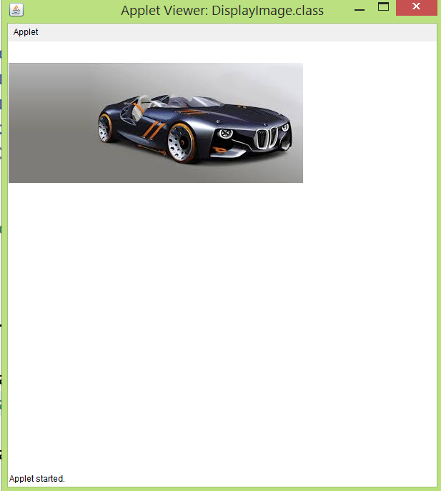
Output

Slide 36
EventHandling in Applet
As we perform event handling in AWT or Swing, we can perform it in applet also. Let's see the simple example of event handling in applet that prints a message by click on the button.

Slide 37
Example of EventHandling in applet
import java.applet.*;
import java.awt.*;
import java.awt.event.*;
public class EventApplet extends Applet implements ActionListener{
Button b;
TextField tf;
public void init(){
tf=new TextField();
tf.setBounds(30,40,150,20);
b=new Button("Click");
b.setBounds(80,150,60,50);
add(b);add(tf);
b.addActionListener(this);
setLayout(null);
}
public void actionPerformed(ActionEvent e){
tf.setText("Welcome");
}
}

Slide 38
Note
In the above example, we have created all the controls in init() method because it is invoked only once.

Slide 39
myapplet.html
<html>
<body>
<applet code="EventApplet.class" width="300" height="300">
</applet>
</body>
</html>

Slide 40
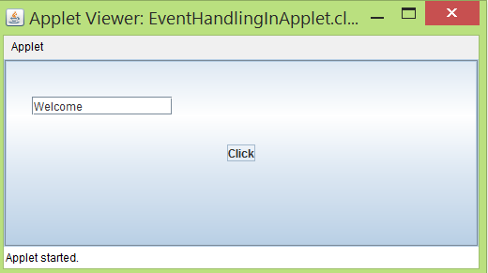
output

Slide 41
JApplet class in Applet
As we prefer Swing to AWT.
Now we can use JApplet that can have all the controls of swing.
The JApplet class extends the Applet class.

Slide 42
Example of EventHandling in JApplet
import java.applet.*;
import javax.swing.*;
import java.awt.event.*;
public class EventJApplet extends JApplet implements ActionListener{
JButton b;
JTextField tf;
public void init(){
tf=new JTextField();
tf.setBounds(30,40,150,20);
b=new JButton("Click");
b.setBounds(80,150,70,40);
add(b);add(tf);
b.addActionListener(this);
setLayout(null);
}
public void actionPerformed(ActionEvent e){
tf.setText("Welcome");
}
}

Slide 43
Painting in Applet
import java.awt.*;
import java.awt.event.*;
import java.applet.*;
public class MouseDrag extends Applet implements MouseMotionListener{
public void init(){
addMouseMotionListener(this);
setBackground(Color.red);
}
public void mouseDragged(MouseEvent me){
Graphics g=getGraphics();
g.setColor(Color.white);
g.fillOval(me.getX(),me.getY(),5,5);
}
public void mouseMoved(MouseEvent me){}
}

Slide 44
Note:
In the above example, getX() and getY() method of MouseEvent is used to get the current x-axis and y-axis. The getGraphics() method of Component class returns the object of Graphics.

Slide 45
Parameter in Applet
We can get any information from the HTML file as a parameter.
For this purpose, Applet class provides a method named getParameter().
Syntax:
public String getParameter(String parameterName)

Slide 46
Example of Using Parameter in Applet
import java.applet.Applet;
import java.awt.Graphics;
public class UseParam extends Applet{
public void paint(Graphics g){
String str=getParameter("msg");
g.drawString(str,50, 50);
}
}

Slide 47
myapplet.html
<html>
<body>
<applet code="UseParam.class" width="300" height="300">
<param name="msg" value="Welcome to applet">
</applet>
</body>
</html>

